Slide 1
Performance Assessment
Abegail T. Abaño

Slide 2
Performance Based Assessment

Slide 3
How can I measure the students achievements, working habits, behavior or attitude?

Slide 4
What is Performance Assessment or Performance based assessment?

Slide 5
What is Performance Assessment?
According to Nitko & Brookhart, 2011:
Require students to create a product or demonstrate a process or both.
Uses clearly defined criteria to evaluate the qualities of student work.

Slide 6
What is Performance Assessment?
One in which a teacher observes and makes a judgment about the student’s demonstration of a skill or competency in creating a product, constructing a response, or making a presentation.
Emphasis on student’s ability to perform tasks by producing their own work with their knowledge and skills.

Slide 7
Why Performance Assessment?
According to Ouano and Tolentino, 2010:
Learning is a complex as human behavior thus, pen-and-paper test is inadequate.
It allows you to assess skills that are both meaningful and relevant to the student.
Lastly, learning is effective in the realm of “doing.”

Slide 8
Traditional vs. Performance
Recall
Identify
List
Match
Classify
Compare
Analyze
Evaluate
Do you know it? Can you use it?

Slide 9
5 Common Domains for Performance Assessment
Communication Skills
Psychomotor Skills
Athletic Activities
Peformance
Assessment
Affective Skills
Concept Acquisition

Slide 10
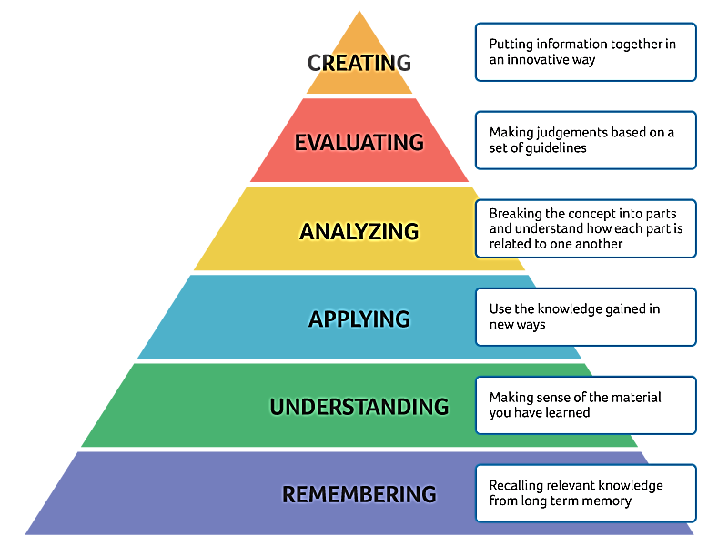
Blooms Taxonomy

Slide 11
The following characteristics should be remembered when designing a performance task:
It has various outcomes; it does not require one right answer.
It is integrative, combining different skills.
It encourages divergent thinking.
It can include opportunities for peer interaction and collaborative learning.
It focuses on both process and product.

Slide 12
What are the types of Performance Assessment?

Slide 13
What are the types of Performance Assessment?
1. Process-Oriented Performance Assessment
2. Product-Oriented Performance Assessment

Slide 14
Process-Oriented Performance Assessment

Slide 15
What are the types of Performance Assessment?
Process-Oriented Performance Assessment
It refers to the type of assessment that mainly focuses on the ability of the students/learners to arrive or produce or demonstrate their own learning.

Slide 16
What are the types of Performance Assessment?
Process-Oriented Performance Assessment
The teacher will focus on how the learner produced or conducted the learning task simply, you are focusing on the skills of the learner.

Slide 17
Product-Oriented Performance Assessment

Slide 18
What are the types of Performance Assessment?
Product-Oriented Performance Assessment
You focus on the product of the learner and not the learner.

Slide 19
Before you conduct a performance assessment…
Does the task truly match the outcome(s) you’re trying to measure?
Does the task require the students to use critical thinking skills?
Is the task worthwhile use of instructional time?
Does the assessment use engaging tasks from the “real world”?

Slide 20
