Slide 1
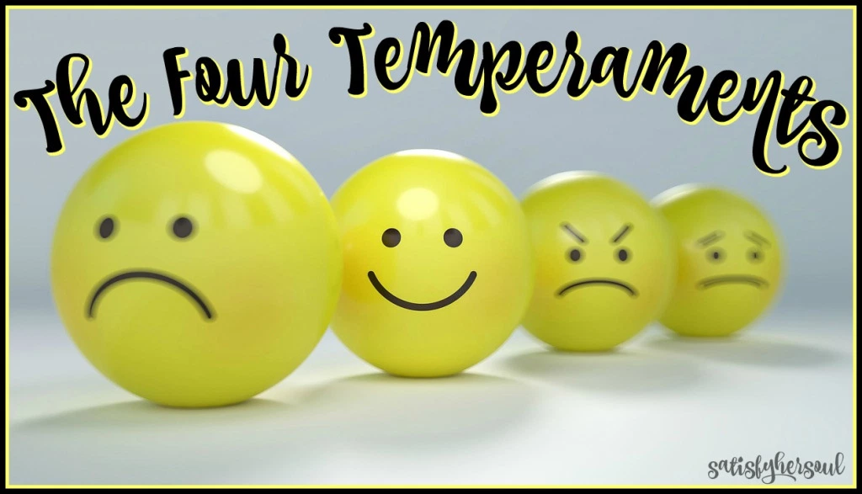
YOU ACT, WHAT YOU FEEL
Prepared by:
Eliada C. Santos
Teacher I

Slide 2
They are our patterns of behaviour..the ways we usually respond to situation.
It is also defined as a persons nature one usual way of thinking or acting.

Slide 4
Let us check your
Personality Temperament!

Slide 5
All of us have all four temperaments within us.
But one or two of them is/are dominant
They control our actions and behaviour
They have their strengths and weaknesses
None of them is good or bad, it depends on how you use them

Slide 6
CHOLERIC (FIRE)
(Destructive Temperament) – Extrovert leader
• According to scholars, Choleric is the most powerful and destructive temperament.
• They tend to be users
• They do not forget easily
• They are very quick tempered
• They seldom change their mind even if they are wrong
• They want total control over themselves and everyone around them.

Slide 7
CHOLERIC (FIRE)
(Destructive Temperament) – Extrovert leader

Slide 8
PHLEGMATIC (WATER)
(Peace Maker)
• This is the only temperament that is basically moderate
• They are very peaceful at heart making them great assets social, political, friendship, business etc.
• They seldom use ideas and talents they have because it requires to much energy and active participation.
• They sit back and watch other temperaments busy doing things wrongly and looking at all the wrong things in the world that need to be changed
• They easily identify the injustice but hardly take any action

Slide 9
PHLEGMATIC (WATER)
(Peace Maker)

Slide 10
SANGUINE (AIR)
(Quick tempered)
• A sanguine is an extrovert who has a high need to include and be close to others.
• A sanguine is always cheerful, hopeful, confident
and expect the best in everything he/she does in life. They always enjoy life
• A sanguine never thinks of failure or loss in everything
• They are authoritative or autocratic

Slide 11
SANGUINE (AIR)
(Quick tempered)

Slide 12
MELANCHOLIC (EARTH)
(Perfectionist)
Melancholic's approach very few people for association and they do not like to be approached for association.
• They are very selective with whom they socialise.
• According to scholars, melancholics are very family oriented,closely bonded to individuals within the family unit.
• They see life as a goal to achieve . Due to their intelligence they predict pitfalls in a project before they undertake it

Slide 13
MELANCHOLIC (EARTH)
(Perfectionist)
They are perfectionists and set very high standards for themselves and for other people around them.
They are self motivated and do not respond to the promise of reward or the threat of punishment
They become very sad when things go wrong
Therefore they analyse and plan before done and want it to be very perfect.
They can be extremely quiet people who never talk to many.

Slide 14
MELANCHOLIC (EARTH)
(Perfectionist)

Slide 15
Why Know Your Temperament being aware of our temperaments can help us
• To better understand each other’s and our own behaviours
• To better appreciate and more fully use what gifts we have
• To appreciate our differences
• To find ways of bridging these differences
• To live peacefully with each other

